Slide 1

Entrepreneurial Management Versus Entrepreneurial Leadership
Avimanyu Datta, Doctoral Candidate

Slide 2
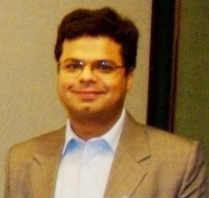
My Background
Worked as a consultant with Frost & Sullivan and Access Markets International (AMI)-Partners. Clients include IBM, SAP, HP-Compaq, Intel, AMD, Cisco Systems and so forth
Currently, Doctoral Candidate at WSU. Investigating process of Commercialization of Innovations
If you are insomniac, I suggest you visit http://avimanyu.weebly.com for the ultimate pill.

Slide 3

Some Lessons Learned
Notes:
3

Slide 4
It is necessary to continuously challenge your comfort zones with an idea, or concept.
“Whatever you do will be insignificant, but it is very important that you do it.” M.K. Gandhi
“Imagination is more important than knowledge.”
Albert Einstein
Organizations need to run very fast to remain in their positions.

Slide 5
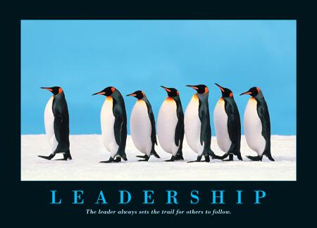
Management Versus Leadership
Plan, organize, direct, and control…
Versus
Having a vision and inspiring others to follow you in pursuing it…

Slide 6
Discovering the Leader Within
Understanding Leadership
Understanding Yourself
Shoring Up Weaknesses
Visioning
Vision Into Action
Developing a Team
Motivating Others
Notes:
6

Slide 7
Critical Success factors for an Entrepreneurial Leader
ATTITUDE!
Positive outlook
Have fun, and fun to be with
Draw people in
Problem solver, not problem finder
Analytical AND entrepreneurial
Everybody is smart and has drive,
but who are the leaders?
Notes:
8/21/2010
1302 Biotech luncheon in-out 9-05
7

Slide 8
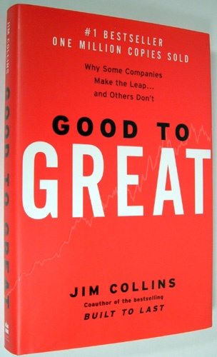
Five Levels of Leadership:
5) Level 5 Executive
4) Effective Leader
3) Competent Manager
2) Contributing Team Member
1) Highly Capable Individual
Jim Collins, “Good to Great”
Notes:
8/21/2010
1302 Biotech luncheon in-out 9-05
8

Slide 9

Five Levels of Leadership:
1) Highly Capable Individual
Makes productive contributions through
talent, knowledge, skills and good work
habits.
Jim Collins, “Good to Great”
Notes:
8/21/2010
1302 Biotech luncheon in-out 9-05
9

Slide 10
Five Levels of Leadership:
2) Contributing Team Member
Contributes individual capabilities to the
achievement of group objectives and
works effectively with others in a group
setting.
Jim Collins, “Good to Great”
Notes:
8/21/2010
1302 Biotech luncheon in-out 9-05
10

Slide 11
Five Levels of Leadership:
3) Competent Manager
Organizes people and resources toward
the effective and efficient pursuit of
predetermined objectives.
Jim Collins, “Good to Great”
Notes:
8/21/2010
1302 Biotech luncheon in-out 9-05
11

Slide 12
Five Levels of Leadership:
Effective Leader
Catalyzes commitment to and vigorous
pursuit of a clear and compelling vision,
stimulating higher performance standards.
Jim Collins, “Good to Great”
Notes:
8/21/2010
1302 Biotech luncheon in-out 9-05
12

Slide 13
Five Levels of Leadership:
5) Level 5 Executive
Builds enduring greatness through a
paradoxical blend of personal humility and
professional will.
Jim Collins, “Good to Great”
Notes:
8/21/2010
1302 Biotech luncheon in-out 9-05
13

Slide 14
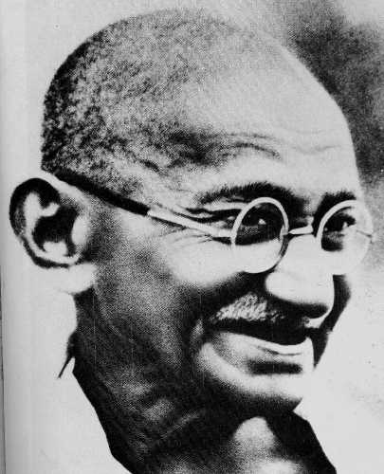
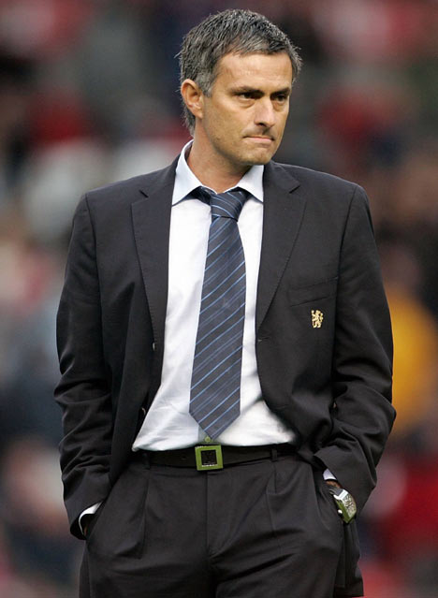
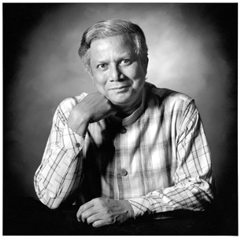
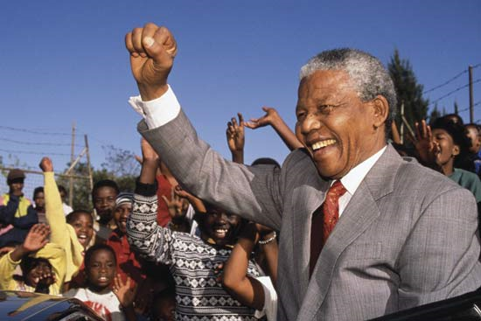
Great Leaders
Notes:
14

Slide 15
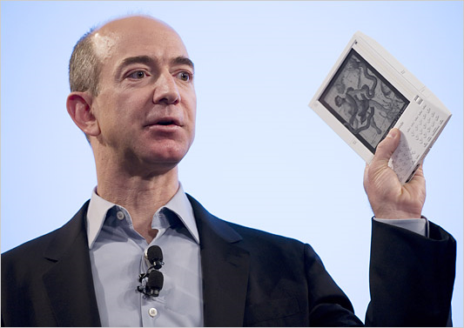
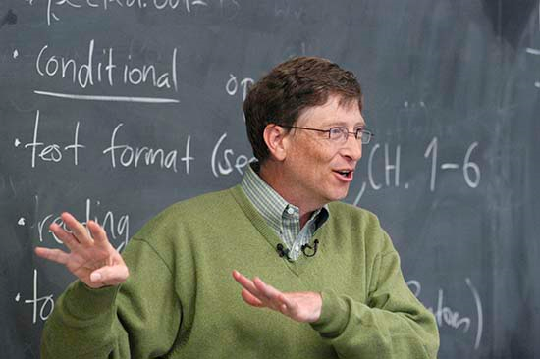
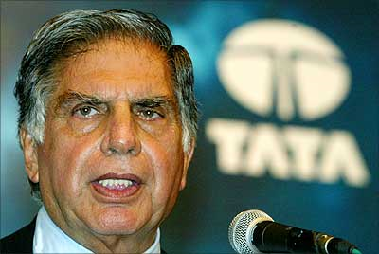


Great Entrepreneurs
Notes:
15

Slide 16
Wikipedia: What is entrepreneurship?
Entrepreneurship is the practice of starting new organizations or revitalizing mature organizations, particularly new businesses generally in response to identified opportunities.
Entrepreneurship is often a difficult undertaking, as a vast majority of new businesses fail.
Entrepreneurial activities are substantially different depending on the type of organization that is being started.
Entrepreneurship ranges in scale from solo projects (even involving the entrepreneur only part-time) to major undertakings creating many job opportunities.
Camp de Fiori Market in Rome

Slide 17
What does it mean to be an entrepreneur?
From the French, entreprendre, which means “to undertake”
Merriam-Webster Dictionary, one who organizes, manages, and assumes the risks of a business or enterprise
QuickMBA, a person of very high aptitude who pioneers change, possessing characteristics found in only a very small fraction of the population

Slide 18
Characteristics of an Entrepreneur
Courage
Action Oriented
Leadership
Positive Attitude
Optimistic
Enthusiastic
Passionate
Confident
Innovative
Creative
Opportunistic
Visionary
Architect and Builder
High Need for Achievement
Not Afraid of Failure
Determined and Persistent
Promoter
Flexible and Adaptable
Pioneer
Agent of Change
Tolerant of Risk
Tolerant of Ambiguity
Pragmatic
Independent
Not Willing to Work for Others
Clever
Resourceful
Note: One person may have all the skills, that is why it is important to find someone who can complement your skills, while sharing your values and vision.

Slide 19

Need For Sustained, Successful Innovation, and Subsequent Commercialization
Environment demands it
“Commercialization” is key
Applies to every firm
CEO as entrepreneur
Commercialization is the means by which an innovation is seen by its users.
Notes:
19

Slide 20
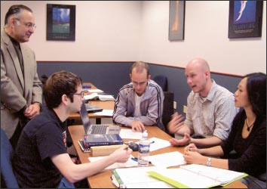
Does the MBA Kill Innovation?
Yes.
“For many years, business programs have produced master of business administration graduates with keen analytical skills, eager to be mid-level managers who were ready to sharpen their pencils to find the weaknesses that would ultimately kill ideas.”
Most Entrepreneurs and Leaders are not MBAs.
Notes:
20

Slide 21
A Framework for Examining Your Leadership Role
Vision
Values
Balance
Self-Awareness
Changing Context and Demands on leadership

Slide 22
Changing Context and Demands
What is the context of your current leadership role?
Vision
What is your personal vision, and is leadership a part of that vision
Do you also have your leadership vision
Values
Are your personal and leadership visions based on your core values?
Self Awareness
Balance
What personal characteristics support your work as a leader and give your work its own distinctive style?
Do you have an adequate balance and focus in your life, resulting from a good integration between your leadership work and other aspects of your life
What special expectations and realities do leaders face today?
What view of leadership prevail in your current situation, and what are your assumptions?

Slide 23
Costs of Leadership
Visibility
Public Duties
Separation (Not one of the gang)
Caretaking and Emotional Strain
Stamina
Job Insecurity
Less Freedom of Expression
Infrequent Relief
Strains on Family
Less Supportive Feedback

Slide 24
Make It So
Those who dream by night in the dusty recesses of their minds wake in the day to find that all was vanity; but the dreamers of the day are dangerous men, for they may act their dream with open eyes, and make it possible. T. E. Lawrence
Notes:
24

Slide 25
Questions /Comments/ abuse? adatta@wsu.edu avimanyu.datta@gmail.com
Notes:
25

