Slide 1
HP-Compaq Merger
Avimanyu(Avi) Datta
Doctoral Candidate, College of Business
Washington State University

Slide 2
Compaq pre-merger
Compaq – Founded in 1982
Primary strength - Innovation
Compaq’s primary business divisions –
Access, commercial and consumer PCs
Enterprise computing: servers and storage products
Global services
Market leader in PCs, with more international sales than US
Market leader in fault tolerant computing and industry standard servers

Slide 3
Compaq pre-merger
Compaq had successfully created a direct model in PCs
#2 in the PC business, stronger on the commercial side
Continuously weakening performance made Compaq directors impatient
Dell became strong competitor through cost efficiency
Compaq missed the online bus and its made-to-order system through its retail outlets failed to take off due to bad inventory management

Slide 4
Compaq pre-merger
To bring Compaq to the online market, Capellas (CEO) bought Digital Equipment (AltaVista)
Acquisition was incohesive resulting in 15000 layoffs and loss in 1998
New management lacked the cutting edge to maintain stability
Bad investments
Got caught in a cycle of cost cutting and layoffs
Firm was too small and poorly run to maintain its wide array of products and services

Slide 5
Hewlett Packard – pre-merger
Started in 1938 by two Stanford graduates – William Hewlett and David Packard. HP incorporated in 1947
HP introduced its first PC in 1980 and the LaserJet (company’s most successful product) in 1985
In 2000, HP had 85,000 employees and revenues of $48.8 bn
Ranked 13th among Fortune 500

Slide 6
Growing problems at HP
HP was not adapting to technological innovation fast enough
Margins were going down
IPG (HP’s Imaging and Printing Group) was the leader in its market segment but did not rank anywhere among top 3 in servers, storage or services
Printing line was facing competition from Lexmark and Epson which were selling lower-quality inexpensive printers
Needed to build strong complementary business lines

Slide 7
Fiorina tries to rejuvenate HP
Carly Fiorina joined in 1999 hoping to excite a complacent HP
Cut salaries, laid off employees
Wanted to make high end computers HP’s focus
According to her, home and business PCs, UNIX servers were the biggest areas of growth

Slide 8
Pre-merger statistics for Compaq and HP
Company | Market share in high end servers | Revenue
Compaq | 3% | $134 mn
HP | 11.4% | $512mn
Company | Market share in mid-range UNIX servers | Revenue
Compaq | 4% | $488 mn
HP | 30.3% | $3,675 mn
Company | Market share in laptops for quarter 2 (volume share) | Market share in PCs for quarter 2 (volume share)
Compaq | 12.1% | 11.6%
HP | 6.9% | 4.5%

Slide 9
HP’s position before merger
By 2001, as the industry stumbled, meeting growth targets became difficult for HP and it was forced to cut jobs and scrap plans
As a result HP stock price dropped drastically.
Turning the company around required more than just strategy from within

Slide 10
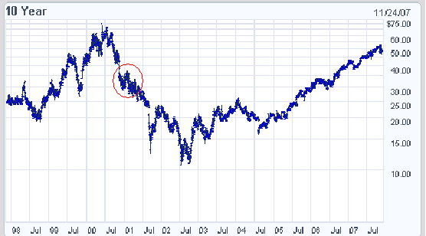
Falling stock prices prior to merger
Back

Slide 11
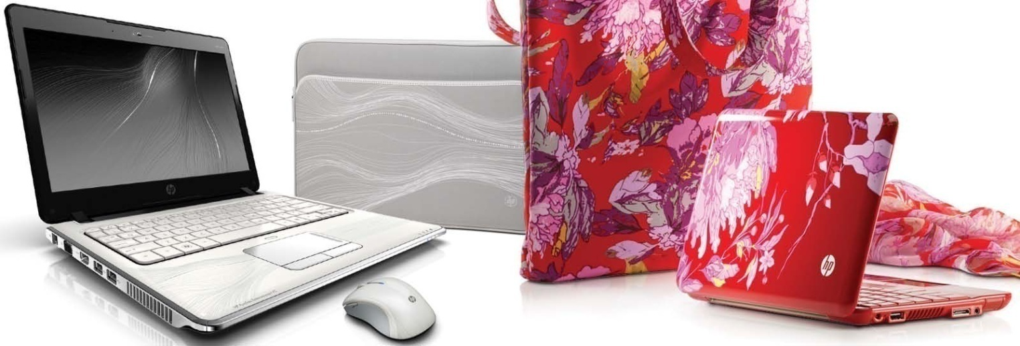
Scenario Building – Desktop Computing Business
Fueled by Competition and Changing Market
New Product Introductions and Improvements
Technology Commodity Business – Courtesy : Dell
Segments - High End Server & Low Margin High Volume
Notes:
Hewlett-Packard, the second largest computer company behind IBM with revenues of $45 billion, saw its share price plummet from a split adjusted
$68 a share in mid-2000 to $30 by the end of 2001.
High end server market dominated by IBM, HP struggling to keep up
HP was number 3, with Dell being the market leader and Compaq no.2
Both HP and Compaq were struggling companies
HP alone could not compete with Dell in the Low-cost, high volume PC market.
Compaq wanted to achieve expertese in High end UNIX servers.
Carley Fiorina, the then HP CEO, wanted to change the backward approach of HP, through the deal.
“Slow motion collision of two garbage trucks”
September
2000 an $18 billion bid for the consulting arm of PriceWaterhouse Coopers (PwC). At that time, HP’s Services Group accounted for about 1 percent of the market for IT services. The market was huge, estimated to exceed $660 billion in 2000, and fragmented; Compaq also had an estimated 1 percent of the market and IBM was the industry leader with 5 percent. The deal would have transferred PwC’s 31,000-strong army of information system consultants to HP’s small IT services group. HP’s goal was to garner a higher percentage of its revenue from high margin services. Services were becoming increasingly important sources of revenue for other technology companies. For example, by 2001, IBM obtained one-third of its revenue from its Global Services arm
The company lost more money in the three years following the merger than in its entire previous history: more than $2 billion by the end of 2000. Compaq also lost its position as America’s leading PC maker, having been passed by both Dell and HP in the retail market. Compaq’s president and CEO, Eckhard Pfeiffer who engineered the deal, was fired within a year of the purchase - If this experience did not scare off Fiorina, it probably gave HP’s investors pause

Slide 12
Potential impact of Merger
Merger would create a full-service technology firm capable of doing everything from selling PCs and printers to setting up complex networks
Merger would eliminate redundant product groups and costs in marketing, advertising, and shipping, while at the same time preserving much of the two companies’ revenues.

Slide 13
Market Benefits
Merger will create immediate end to end leadership
Compaq was a clear #2 in the PC business and stronger on the commercial side than HP, but HP was stronger on the consumer side. Together they would be #1 in market share in 2001
The merger would also greatly expand the numbers of the company’s service professionals. As a result, HP would have the largest market share in all hardware market segments and become the number three in market share in services.
Improves access to the market with Compaq’s direct capability and low cost structure
The much bigger company would have scale advantages: gaining bargaining power with suppliers; and scope advantage: gaining share of wallet in major accounts .

Slide 14
Operational benefits of Merger
HP and Compaq have highly complimentary R&D capabilities
HP was strong in mid and high-end UNIX servers, a weakness for Compaq; while Compaq was strong in low-end industry standard (Intel) servers, a weakness for HP
Top management has experience with complex organizational changes
Merger would result in work force reduction by around 15,000 employees saving around $1.5 billion per year

Slide 15
Considerations for Merger
HP’s strategy is to move to higher margin less commodity like business, hence merging with Compaq is a strategic misfit.
Larger PC position resulting from the merger is likely to increase risk and dilute shareholders interest in imaging and printing
Lower growth prospects on invested capital
Market position in key attractive segments remain same
Services remain highly weighed to lower margin segment
No precedent for success in big technology transactions
Market reaction for the merger is negative
Revenue risk might offset synergies
HP and Compaq have different cultures
Increased equity risk and hence cost of capital

Slide 16
Summary of Deal
Announcement Date | September 4, 2001
Name of the merged entity | Hewlett Packard
Chairman and CEO | Carly Fiorina
President | Michael Capellas
Ticker symbol change | From HWP to HPQ
Form of payment | Stock
Exchange Ratio | 0.6325 HPQ shares to each Compaq Shareholder
Ownership in merged company | 64% - former HWP shareholders 36% - former CPQ shareholders
Ownership of Hewlett and Packard Families | 18.6% before merger 8.4% after merger
Accounting Method | Purchase
Merger method | Reverse Triangular Merger

Slide 17
Reverse Triangular merger
A subsidiary Heloise Merger Corporation was created solely to facilitate the merger
Result : A tax free reorganization in which HP would control all of Compaq’s assets through a wholly owned subsidiary
Compaq
Hewlett Packard
Stock (Cash for fractional shares)
Compaq Shareholders
Heliose Merger Corp
Stock

Slide 18
TRADING PERFORMANCE IN THE WAKE OF THE ANNOUNCEMENT
Date | HWP Closing Price (in $) | HWP Percentage Change | CPQ Closing Price (in $) | CPQ Percentage Change
8/28/2001 | 24.61 | -1.6% | 13.32 | 0.4%
8/29/2001 | 23.95 | -2.7% | 13.13 | -1.4%
8/30/2001 | 23.40 | -2.3% | 12.69 | -3.4%
8/31/2001 | 23.21 | -0.8% | 12.35 | -2.7%
9/4/2001 | 18.87 | -18.7% | 11.08 | -10.3%
9/5/2001 | 18.21 | -3.5% | 10.41 | -6.0%
9/6/2001 | 17.70 | -2.8% | 10.35 | -0.6%
9/7/2001 | 18.08 | 2.1% | 10.59 | 2.3%

Slide 19
Deal Valuation
The final Exchange Ratio | 0.6325 HPQ shares per Compaq share
Exchange ratio implied by the market as on 31 Aug, 2001 | 0.5356 HPQ shares per Compaq share
Exchange ratio implied by the 12 month market performance of HP and Compaq stocks | 0.596 HPQ shares per Compaq share
Compaq’s Valuation by the market pre-merger announcement | $20.995 billion
Compaq’s Valuation by HP as implied by the final exchange ratio | $24.995 billion

Slide 20
Deal Valuation (Contd..)
Acquisition Premium
Acquisition Premium is the difference between the worth of a Compaq share as valued by HP and the market valuation of a Compaq share
The Premium will depend on the length of the period considered while determining the market valuation of Compaq
Period ending Aug 31 2001 | Average Exchange ratio | Implied Acquisition Premium paid by HP (in %)
Aug 31, 2001 | 0.535 | 18.9
10 day average | 0.544 | 16.3
30 day average | 0.573 | 10.3
3 month average | 0.557 | 13.7
6 month average | 0.584 | 8.2
12 month average | 0.596 | 6.1

Slide 21
Valuing the Merger was a challenge because….
Recession : The largely negative outlook for the economy overall and the tech sector in particular circa 2001
Volatile trading activity : NASDAQ suffered a 30% drop in the 12 months preceding the merger announcement
Valuation multiples for comparable companies and recent comparable transactions were broadly distributed.

Slide 22
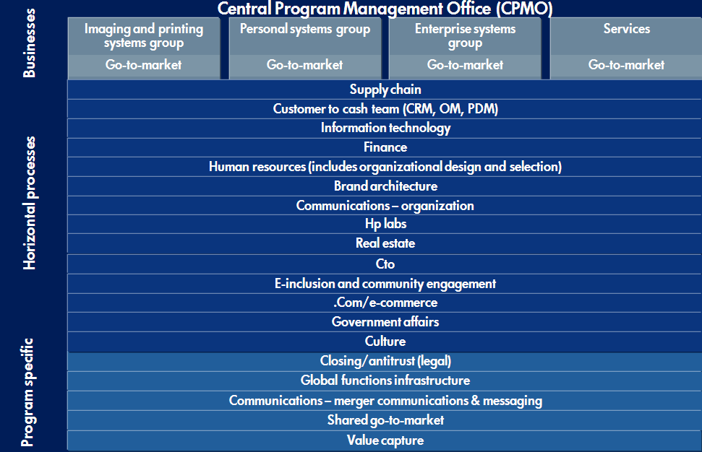
Merger Team Structure

Slide 23
Post Merger integration
Merger Integration Team Size: 1200
Big Bang concept:
Communicate merger to Channel partners, customers
Both companies are in similar businesses: Combine Product road maps
Deliver on the short-term synergies in six to 12 months
They don't need two Unix or NT development teams
15,000 Jobs Eliminated
HP:6000
Compaq: 8500
Problems with sackings: Even talent packs their bags
Achieving the integration will be tied to peoples compensation packages
Human resource integration
INTRANET
Operations management integration
Sales force Integration
Notes:
HP's network storage high-end servers and enterprise software business: 11/18 Top Managers are currently Compaq employees
IT Services 9/13 HP Managers
HP Personal Systems Group 9/13 HP Managers
Customer Facing (Front
End)/Product Facing (Back End)” reorganization in 1999-2000 had taken longer than planned

Slide 24
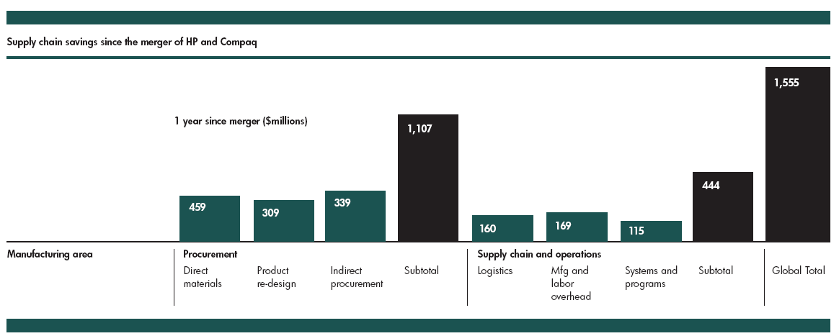
Operational Efficiencies
Achieved merger-related cost savings of more than $1.3B annually
Restructured direct material procurement to save $450M annually
Redesigned products & re-qualifying components to save $300M
Consolidated multiple mfg sites achieving $120M in annualized savings
Achieved manufacturing savings of $200M annually
Reduced supply chain headcount by 2,700
Realized logistics savings of $100M+ annually
Indirect Procurement negotiated annual savings of $220M

Slide 25
Strategic Integration
Out-compete Dell: The new HP needed a highly competitive direct sales model
- 50% of retail shelf space was occupied by HP & Compaq
- Direct sales model benefited from Compaq direct sales model
Out-compete IBM
- Manage the high level relationships with global enterprise customers
- With help of Compaq consultants managed 40 big deals in competition with IBM

Slide 26
Shareholder value
Myth:
A strategically poor integration will be reflected by the stock market’s pushing the combined company's stock price down , an illustration of how mergers can destroy value
Fact :
In mid-July 2007, five years after the merger announcement, HP's total shareholder returns were up 46 percent. Over the same period, the Standard & Poor's IT index had sunk 9 percent, rival IBM was down 23 percent, and even Dell was up only 2 percent.

Slide 27
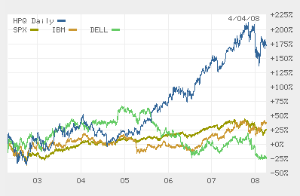
HP Stock Price Movment Till 2008

Slide 28
PC business
Myth:
HP, even after combining with Compaq, cannot fight Dell’s direct-sales model with their retail (indirect) plus direct model
Fact :
HP’s PC business has steadily improved and is bringing competition to Dell that Dell has not seen for the past 5 or 10 years
Dell's PC shipments worldwide share fell to 15.2 % from 18.2 % last year, a particularly sharp decline given that the overall market grew 10.9 percent
Hewlett-Packard holds 19.1 percent of the world PC market
Even in the US, HP and Dell have 24.2 and 26.8 % of the PC market in 2007

Slide 29
Printer business
Myth:
HP is pursuing only market share in printers instead of ROI
Fact :
In HP’s printer business, “good” share consists of devices that deliver color, photos, lots of output, and perform multiple functions. Those characteristics lead to more pages printed, and more profitability. HP has extended that business, leaving low-end, single-function printers to competitors.
The company also refused to respond to Dell price-cutting intended to weaken HP's market share in printers

Slide 30
Server business
Myth:
Pursuing more market share in PCs will divert resources and distract attention from its strengths in printers and servers
Fact :
Vendor | 2007 Revenue (Mn US $) | 2007 Share (%) | 2007 Revenue (Mn US $) | 2007 Share (%) | Growth (%)
IBM | 4069 | 31 | 3824 | 30.9 | 6.4
HP | 3707 | 28.2 | 3424 | 27.8 | 8.0
Sun | 1711 | 13 | 1620 | 13.1 | 5.6
Dell | 1526 | 11.6 | 1270 | 10.3 | 20.2
Fujitsu/Siemens | 542 | 4.1 | 554 | 4.5 | -2.3

Slide 31
Achieved benefits for customers
HP now offers a one-stop shopping experience for global corporate customers—
The company has the ability to procure everything from PDAs to commercial printers and servers from the same source
The economies of scale have helped HP focus on its legacy of manufacturing innovation
It can build and deliver precisely the product that customers need and want to buy.

Slide 32
Achieved benefits for customers
Ease of doing business
The supply chain strategy allows a single point of collaboration with HP, simplifying suppliers’ interaction with HP, increasing business collaboration, and lowering costs for both parties.
Enhanced supply and demand visibility
This visibility improves participants’ ability to predict demand. It also enables suppliers to build purchasing, manufacturing, and logistical efficiencies into their own supply chains. Further, it enables suppliers to pass associated discounts onto customers such as HP
Elimination of non-value-added steps, such as administration, and costs

Slide 33
The Rationalized Product Portfolio
HP branded:
Notebooks
Desktops, workstations
Servers (complete range from high-end to low-end), blade servers, storage
Printers & printing consumables
Scanners
IT Solutions
Compaq
Desktops
Notebooks

Slide 34
QUESTIONS/ COMMENTS?

