Slide 1
MySpace
Avimanyu Datta
Doctoral Candidate, College of Business, Washington State University

Slide 2
MySpace: Snapshot
In the U.S. over 70 million monthly unique visitors view over 34 billion pages
MySpace U.S. visitors spend over 16 billion minutes on the site each month, with an average of 230 minutes per visitor
Source: comScore, inc. February, 2009
Source: comScore, inc. February, 2009

Slide 3
Key Questions
Why is MySpace so Successful?
Compare and Contrast MySpace and FaceBook?
Should MySpace join OpenSocial or invest in its own platform

Slide 4
Benefits of Social Networks
Why is MySpace so Successful?

Slide 5
Why is MySpace so Successful?
3 Benefits
Key Questions:
How to grow?
How to monetize?
How to keep users?
Business

Slide 6
MySpace: Ecosystem
Why is MySpace so Successful?

Slide 7
Growth

Slide 8
MySpace Growth
Why is MySpace so Successful?

Slide 9
Revenue Sources

Slide 10
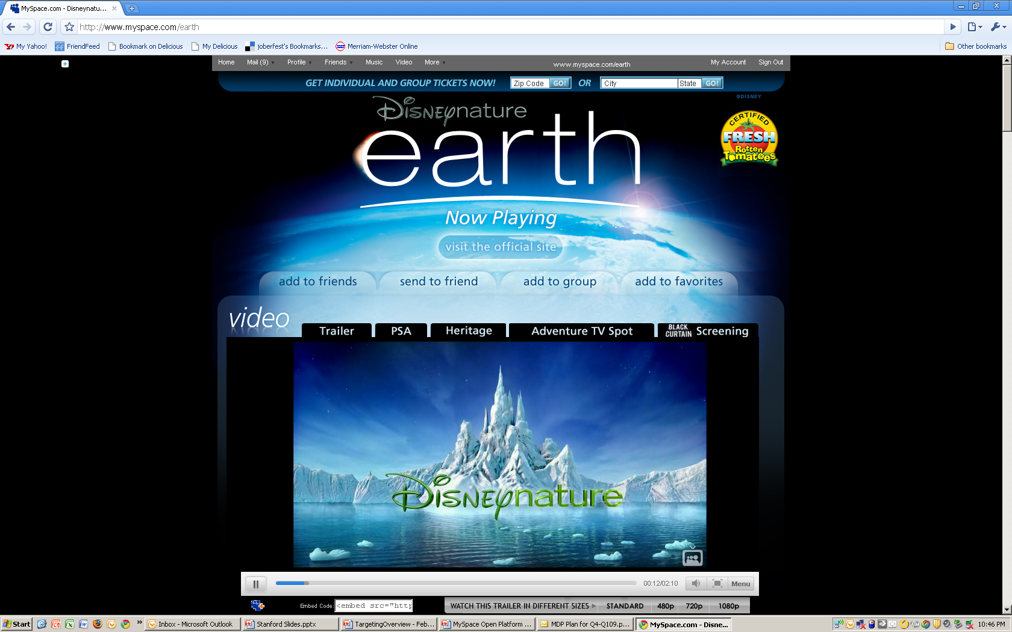
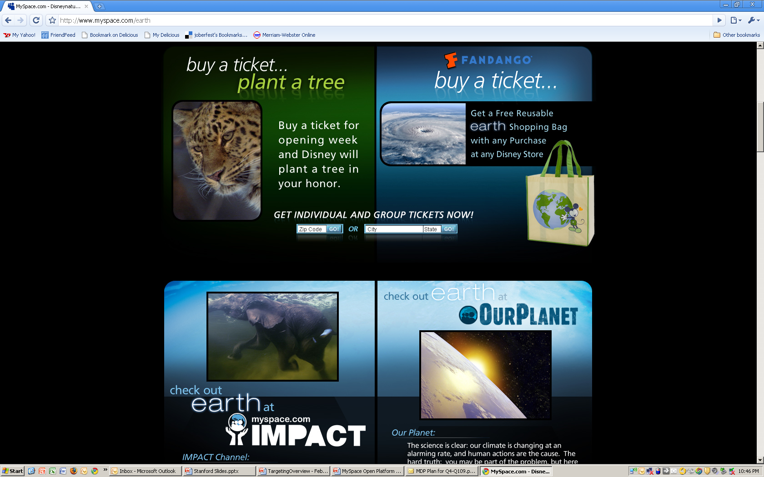
Why is MySpace so Successful?
Integrated Advertising

Slide 11
Why is MySpace so Successful?
Monetization Themes Across Media
High utility content sites deliver higher ad performance
Rich user-provided data is the basis for a superior monetization platform
  A win for users, for advertisers and publishers
Well diversified revenue models are crucial
  e.g. CPM, CPA, CPC
  e.g. Affiliate offers and direct payment
  e.g. Commerce and advertising

Slide 12
Why is MySpace so Successful?
    CPM
      Actively promoted by the big portals such as Yahoo and AOL.
      It was a great revenue generator for them that had the added bonus of being largely risk free.
      The advertiser did all the creative work and made the payments while the only thing the portals had to do was display the ad as often as they could until the advertiser's budget was exhausted.
      It's this one-sided nature of the CPM model that has pushed advertisers to seek an alternative that can offer them some sort of guarantee of performance.
    CPA
      Seems to offer the best guarantee for advertisers.
      The advertiser only pays when the prospect has performed a specific action such as registering or requesting information.
      An ad can be displayed and clicked on many, many times with no cost to the advertiser.
      Wow all the risk has been shifted to the publisher since they now must give up their ad inventory and hope that the advertiser's message is compelling enough to result in "actions“.
      CPC
        Sits in the middle of the online pricing spectrum.
        Involves risk from the advertiser's side in that they pay for every click on their ad. This forces them to make sure that the ad is relevant to what is being offered so that a click has a good chance of turning in to an action.
        The publisher takes on the responsibility of displaying the ad in appropriate places so that it will receive clicks. No clicks, no revenue.

Slide 13
MySpace Revenues
Why is MySpace so Successful?

Slide 14
Stickiness

Slide 15
MySpace Stickiness
Why is MySpace so Successful?

Slide 16

MySpace Vs. Facebook
VS

Slide 17

MySpace Vs. Facebook
USERS
Launched in 2004
20,284,357 members
15,000 new members a day
Up 14.8% in the past month, 88.3% in 2008
Launched in 2004
167 million registered members
208,000 new members a day
57% of Social Networking Market Share
“86.5% of members are 18+”

Slide 18
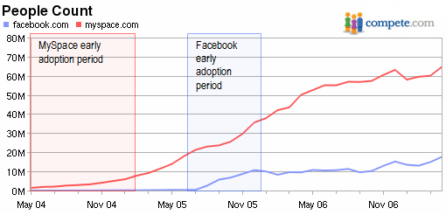
MySpace Vs. Facebook

Slide 19
MySpace Vs. Facebook
Visitor Traffic to Major SN Sites
is Leveling Off
US Unique Visitors to MySpace and Facebook September 2006-February 2008 (thousands)
68 million
32 million

Slide 20
MySpace Vs. Facebook
US MySpace Unique Visitors, by Age, February 2008
US Facebook Unique Visitors, by Age, February 2008

Slide 21
… The Youth Market are Heaviest Users

Slide 22
MySpace Vs. Facebook
FUNCTIONALITY
Facebook MySpace
Profiles
Friends
Messaging
Photo/videos
Comments
Events
Blog
Music
Bulletins
Groups
Profiles
Friends
Messaging
Photo/video
“Wall”
Events
Feeds
Applications

Slide 23
MySpace Vs. Facebook
Stickiness
Facebook MySpace
  Over 71% of early “power users” were using Facebook in May 2007, and visiting the site an average of 27 times a month.
Nearly 2/3rds of early MySpace “power users” were using MySpace in May 2007, and visiting the site an average of 30 times a month.

Slide 24
MySpace Vs. Facebook
CONNECTIVITY
Facebook MySpace
Feeds
Online to offline activities
Group membership/updates
Invitations
Marketplace
Toolbar
Blogs/feeds
Online to offline activities
Group membership/updates
Invitations

Slide 25
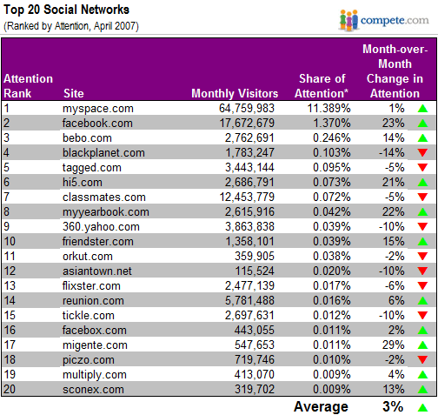
Top 20 Social Networks
(Ranked by Attention, April 2007, Compete.com)
MySpace Vs. Facebook

Slide 26

Should MySpace enter into Google’s Open Social Platform?

Slide 27
Should MySpace enter into Google’s Open Social Platform?
Benefits of joining
  Acquire comparable functionality as that of other competitors; Facebook
  No major investment
Costs of Joining
  Privacy issues
  Only mirroring other competitors; Facebook
  Low cost of investment; major cost on organizational and IT strategies
  How will changes influence user perception

Slide 28
Should MySpace enter into Google’s Open Social Platform?
Arguments against Joining
  Google at some point may steer project against MySpace’s wishes
  Open Social is a confederation of many sites.
  Given the size of MySpace it should not have problems attracting developers to it’s platforms.

Slide 29
Should MySpace enter into Google’s Open Social Platform?
Arguments for Joining
  If MySpace is the biggest member of Open Social, Google will not do anything to undermine MySpace.
  If Open Source becomes a de facto standard, MySpace would cannot afford to maintain a parallel standard. It will be a Wintel Vs Mac in the social networking arena.
  Acquire comparable functionality as that of other competitors.
  May be able to offer better counterweight to Facebook.

Slide 30
Should MySpace enter into Google’s Open Social Platform?
So did MySpace Join Open Social?

Slide 31
Questions/ Comments

