Slide 1
Starbucks and Howard Schultz
Avimanyu Datta
Doctoral Candidate, College of Business
Washington State University

Slide 2
Philosophy
We’re not in the coffee business serving people…
We’re in the people business serving coffee.
-Howard Behar,
Director of Retail Operations

Slide 3
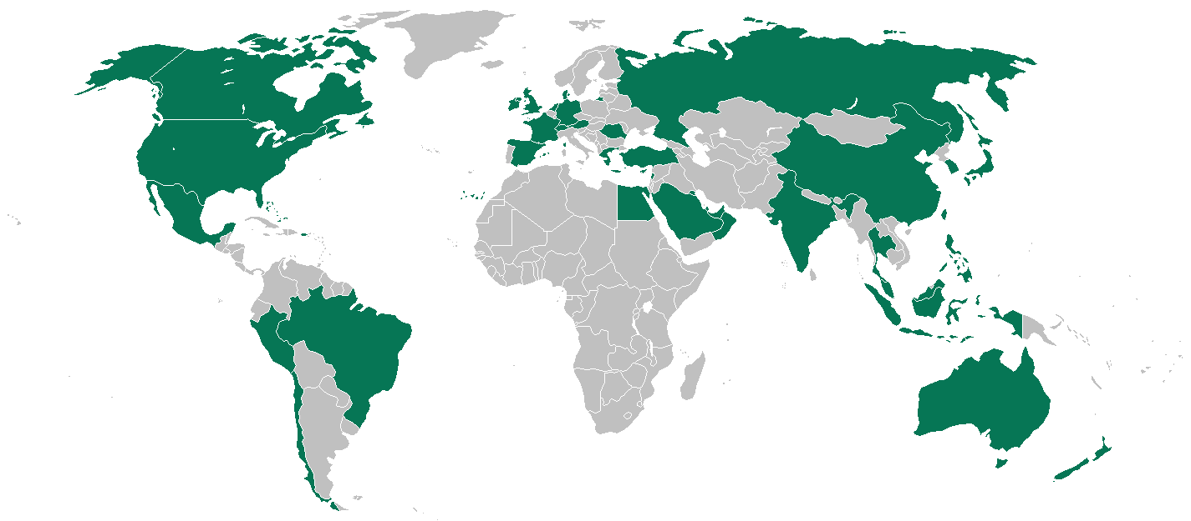
Snapshot
Size
6,793 Company Operated Stores
3,891 Licensed Stores (In Safeway, Albertson’s Etc.)‏
Internationally, there are:
1,712 Company Operated Stores
2,615 Joint Venture and Licensed Stores.

Slide 4
Starbucks Mission Statement
“Establish Starbucks as the premier purveyor of the finest coffee in the world while maintaining our uncompromising principles as we grow.” The following six guiding principles will help us measure the appropriateness of our decisions: - Provide a great work environment and treat each other with respect and dignity. - Embrace diversity as an essential component in the way we do business. - Apply the highest standards of excellence to the purchasing, roasting and fresh delivery of our coffee. - Develop enthusiastically satisfied customers all of the time. - Contribute positively to our communities and our environment. - Recognize that profitability is essential to our future success.

Slide 5
Starbucks Environmental Mission Statement
“Starbucks is committed to a role of environmental leadership in all facets of our business.” We fulfill this mission by a commitment to:
- Understanding of environmental issues and sharing information with our partners.
- Developing innovative and flexible solutions to bring about change.
- Striving to buy, sell and use environmentally friendly products.
- Recognizing that fiscal responsibility is essential to our environmental future.
- Instilling environmental responsibility as a corporate value.
- Measuring and monitoring our progress for each project.
- Encouraging all partners to share in our mission.

Slide 6
Background
Founded by Jerry Baldwin, Zev Siegel, and Gordon Bowker in 1971 in Seattle’s Pike Place Market.
Purchased by Howard Schultz in March of 1987 and turned in into what we see today.
Schultz wanted to create a business that does the right things for the right reasons and is financially successful.

Slide 7
Mission Statement
“Establish Starbucks as the premier purveyor of the finest coffee in the world while maintaining our uncompromising principles while we grow.”
Notes:
7

Slide 8
Guiding Principles
To support their mission statement the following six guiding principles help guide the appropriateness of decisions:
Provide a great work environment and treat each other with respect and dignity.
Embrace diversity as an essential component in the way we do business.
Apply the highest standards of excellence to the purchasing, roasting and fresh delivery of our coffee.
Develop enthusiastically satisfied customers all of the time.
Contribute positively to our communities and our environment.
Recognize that profitability is essential to our future success.
Notes:
8

Slide 9
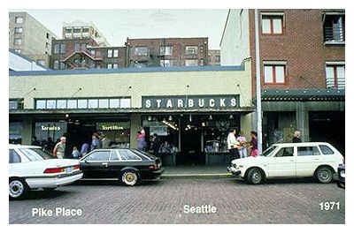
Brief Starbucks Timeline
1971
Starbucks opens its first store in Seattle’s Pike Place Market.
1982
Howard Schultz joins Starbucks as director of retail operations and marketing.
1988
Starbucks offers full health benefits to full and part-time employees.
1997
Starbucks Foundation established, benefiting local literacy programs in communities where Starbucks has coffeehouses.
Starbucks store total circa end of 1999:
2,498.
Original Starbucks logo

Slide 10
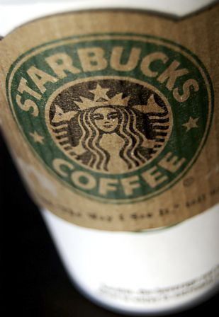
Why is Starbucks Important?
Leaders of coffee industry in sales worldwide.
Focus on customer service at the forefront of business model for more than three decades
Strive to provide memorable customer service at each location, for each transaction.
Innovation: In-store Wi-Fi, new beverages, broad product range, drink customization, etc.
Philanthropically sound business decisions: a “Green” company, charitable donations.
Employee health benefit package extended to part-time employees, training model is world-class.

Slide 11
Starbucks as a Market Leader
Industry: Food Services
Rank Company 500 rank Revenues ($ millions)‏
1 McDonald's 108 21,586.4
2 Yum Brands 262 9,561.0
3 Starbucks 310 7,786.9
4 Darden Restaurants 404 5,720.6
5 Brinker International 502 4,260.2
6 OSI Restaurant Partners 535 3,941.0
7 Wendy's International 562 3,660.3
8 Jack in the Box 685 2,765.6
9 CBRL Group 711 2,643.0
10 Burger King Holdings 842 2,048.0
11 CKE Restaurants 991 1,588.4
12 Bob Evans Farms 993 1,584.8
From the April 30th, 2007 issue of Fortune

Slide 12
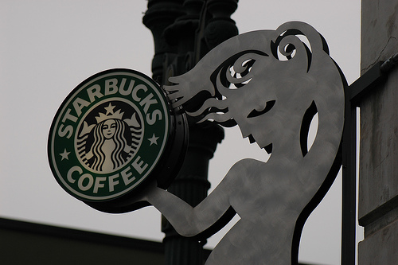
A look at the Starbucks we know today
“Aside from being everywhere, Starbucks seems to have always been everywhere.”

Slide 13
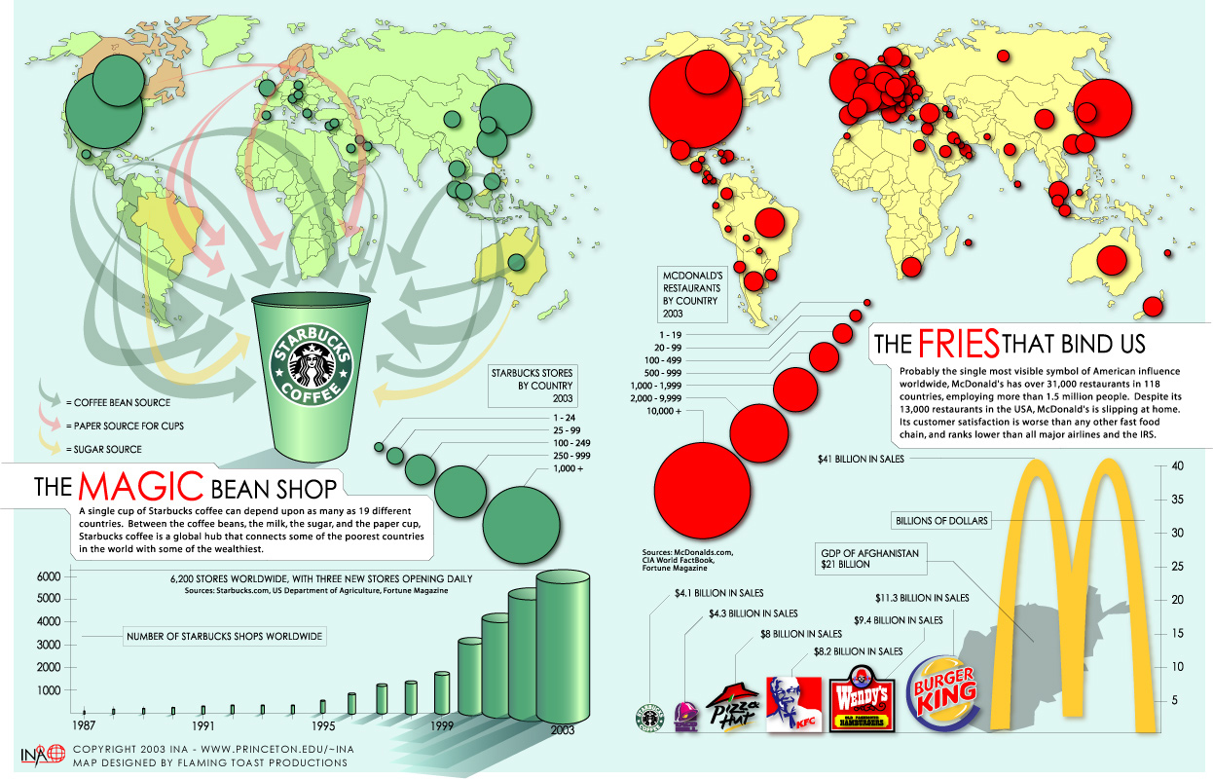

Slide 14
Role in Industry - Recognition
Starbucks is recognized around the world.
Here are just a few of the awards and recognition that they have received:
Recognized as one of “Ten Most Admired Companies in America.” 2003-2006
Among “The 100 Best Companies to Work For.” 1998-2000, 2002-2007
Placed second in 2007 as “Best Ethical Store.”
Named in “Top 25 Green Power Partners.” 2007
“Most Admired Company” in the Food Services category,
2001-05.
“A” rating in Sustainability, 2007
Named in “Top 50 CSR.” 2004

Slide 15
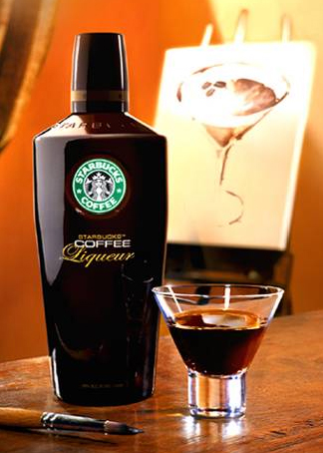
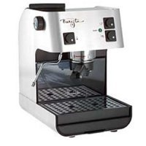
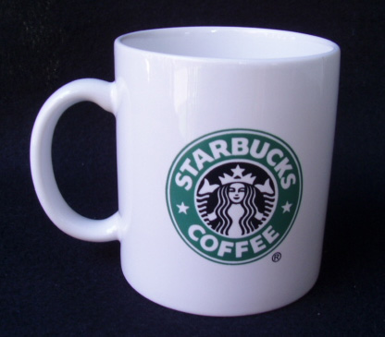
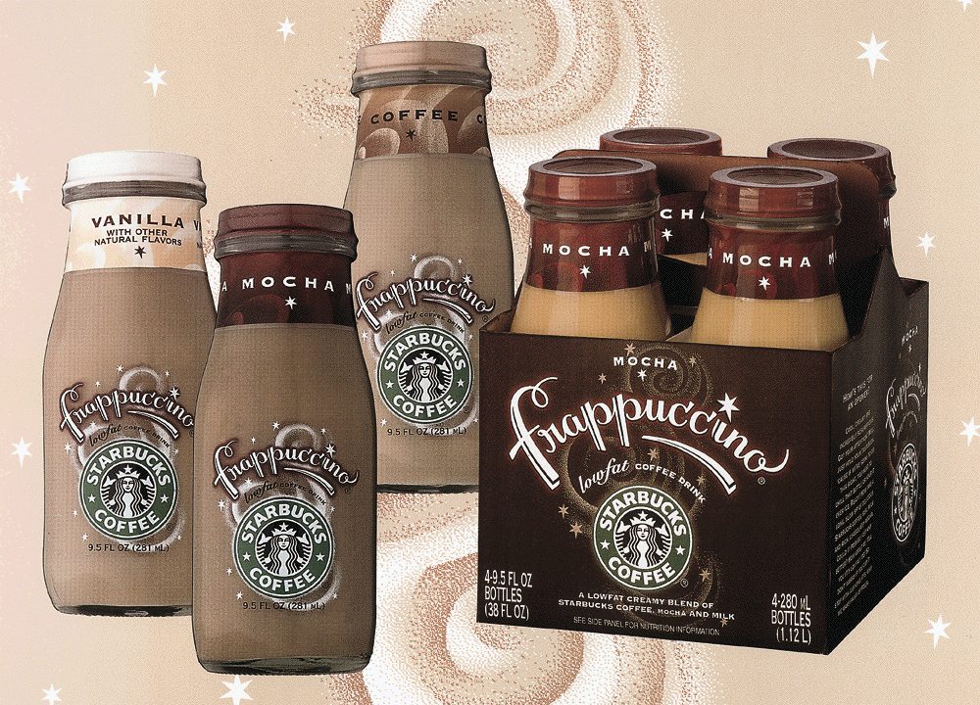
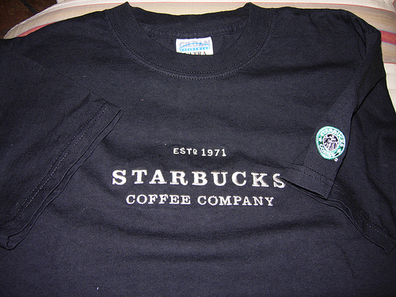
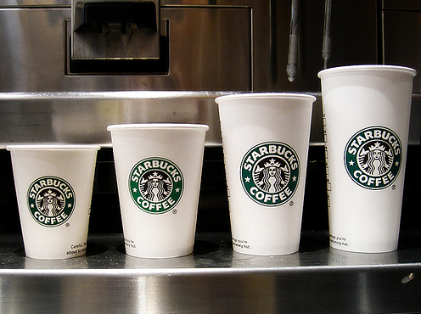
Starbucks in the Boston Consulting Group Matrix
High Market Share Dominance Low
Low Market Growth Rate High
Coffee products, sold as retail
Home Products
Coffee, sold in Starbucks
Other Merchandise

Slide 16
The Role of Management
Chief Financial Officer
Chief Information Officer
Board of Directors
Chief Executive Officer
Director of Corporate Strategy
President
Director of Marketing

Slide 17
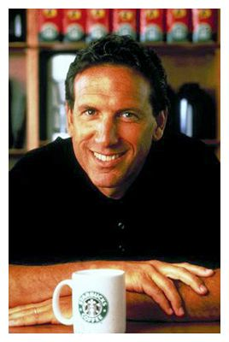
Who is Howard Schultz?
Entered Starbucks in the year of 1982 with the curiosity of what was going on in Seattle.
Schultz flew to Milan, Italy in 1983 and was captured by the essence of the Italian espresso flare.
After working to make Starbucks the “It” thing of coffee, Schultz was named President and Chief Executive Officer of Starbucks Coffee (age 34).
Innovations since have paved way for modern concept of coffeeshop: a multi-faceted establishment, a coffeshop that does more than sell coffee.

Slide 18
Revisiting their Roots:
How the company's history matters today

Slide 19
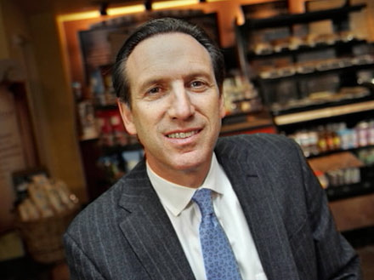
In recent news:
Legendary CEO Howard Schultz makes triumphant return
How he plans to benefit Starbucks:
- Cut away the fat:
Shut down the stores that under-perform in sales.
- Get back to basics:
Customer service is the number one priority.
- Refocus the business model:
Less expansion, more focus on what's already there.
“The majority of our customers make their own proprietary beverage, a double tall latte, vanilla latte, frappuccino. We've made it fun.”
Howard Schultz in 2008

Slide 20
Corporate Strategic Goals
Growth
Number of stores
Increase Net Revenue
Preserve the Starbucks Experience
Be a Leader in Corporate & Social Responsibility
Notes:
MIKE

Slide 21
CSG - Summary
Financial
Net revenue
Same store sales
Earnings per share
10,000 new stores
in four years
Customers
Increase core group
Support shade growth
Sustainability index
CSR
Learning & Growth
Quality employees
Create the “Third Place”
Operations
New store growth
Productivity
Source coffee beans
Notes:
MIKE
21

Slide 22
Causality Tree
Financial
Same store sales
Net revenue
EPS
Customer
Quality Products
CSR
Sustainability
Operations
Productivity
New store growth
Source coffee beans
Learning
Starbucks Experience
Quality Employees
Notes:
Dylan

Slide 23
CSG – Learning and Growth
Attract & Retain Quality Employees
Measure (1): Time to Fill
Target (1): Less than 40 days
Leading Indicator
------------------------------------------------------------------------------------------
Measure (2): Percentage Voluntary Turnover
Target (2): Less than 20%
Lagging Indicator
------------------------------------------------------------------------------------------
Measure (3): Percentage of Positions filled Internally
Target (3): Greater than 50% for Supervisors and 80% for Unit Managers
Lagging Indicator
Source: Internal HR Reports
Notes:
Stephen

Slide 24
CSG – Learning and Growth (cont.)
Maintain High Level of Employee Satisfaction
Measure (1): Employee Satisfaction Survey
Target (1): Greater than 70% Very Satisfied; 90% Satisfied
Leading Indicator
Source: External Survey
------------------------------------------------------------------------------------------
Measure (2): Percent Shrinkage
Target (2): Less than 2%
Lagging Indicator
Source: Financial Books
------------------------------------------------------------------------------------------
Measure (3): Employee Total Compensation
Target (3): 30% above industry average
Leading Indicator
Source: Internal HR Reports
Notes:
Stephen

Slide 25
CSG – Learning and Growth (cont.)
Create the 3rd Place
Measure (1): Employee Retention of Training
Target (1): 90% of Benchmark
Leading Indicator
Source: Periodic Internal testing
------------------------------------------------------------------------
Measure (2): Culture Compatibility Test
Target (2): Score 80 +
Leading Indicator
Source: Structured interview process
------------------------------------------------------------------------
Measure (3): Secret Shopper Evaluation
Target (3): Score of 95.45% (2 σ)
Leading Indicator
Source: Secret Shopper Survey
Notes:
Stepehn

Slide 26
CSG – Operations
Support New Unit Growth
Measure: Sites under consideration vs. Benchmark
Target: 1 : 1
Leading Indicator
Source: Construction Dept. Reports
Productivity
Measure: Net Revenue per Labor Hour per Employee
Target: Greater than $46.85
Lagging Indicator
Source: Financial Books
Notes:
Stephen

Slide 27
CSG – Operations (cont.)
Increase the number of units
Measure: Actual vs. Target
Target: 1 : 1
Lagging Indicator
Source: Construction Dept. Reports
Source top quality coffee beans
Measure (1): Contracts vs. Forecasted Demand
Target (1): 105%
Leading Indicator
Source: Operations & Marketing Report
-------------------------------------------------------------
Measure (2): Purchased vs. Demanded
Target (2): 100%
Lagging Indicator
Source: Operations & Marketing Report
Notes:
Stephen

Slide 28
CSG – Customer
Support shade-grown coffee
Measure: % coffee sourced from shade-grown farms
Target: 25%
Leading Indicator
Source: Sustainability Index
Grow top customers (18+ visits/month)
Measure: # of visits per month
Target: 5% annual growth
Leading Indicator
Source: External Survey
Notes:
Todd

Slide 29
CSG – Customer (Cont.)
Drive Sustainability
Measure (1): % benchmark to index
Target (1): Sustainability index
Leading Indicator
Source: Sustainability index –Dow Jones
-----------------------------------------------------------------------------------------
Measure (2): # recycled paper products
Target (2): 25%
Lagging Indicator
Source: Purchase/Sales reports
Notes:
Todd

Slide 30
CSG – Customer (Cont.)
Corporate and Social Responsibility
Measure (1): % Fair Trade Coffee
Target (1): Maintain or increase % year-to-year
Lagging Indicator
Source: Marketing reports
------------------------------------------------------------------------------------------
Measure (2): % Organic Coffee
Target (2): Maintain or increase % year-to-year
Lagging Indicator
Source: Marketing reports
Notes:
Todd

Slide 31
CSG – Financial
Net Revenue Increase
Measure: Percent increase year-to-year
Target: 20%
Lagging Indicator
Source: Financial Books
Same Store Sales Growth
Measure: Increase over previous period
Target: 3-7%
Lagging Indicator
Source: Financial Books
Notes:
Todd

Slide 32
CSG – Financial (cont.)
Increase Firm Value
Measure: Earnings per share
Target: Increase 3.4% to $0.89 per share
Lagging Indicator
Source: Financial Books
Notes:
Todd

Slide 33
Stakeholder Impact
Beans
Value Chain Partners
Convenience
Consumers
Quality products
Growth
Strategy
Investors
Drive Value / EPS
Employees
Starbucks Experience
Publics
Tax Base / CSR

Slide 34
CSG - Summary
Financial
Net revenue
Same store sales
Earnings per share
10,000 new stores
in four years
Customers
Increase core group
Support shade growth
Sustainability index
CSR
Learning & Growth
Quality employees
Create the “Third Place”
Operations
New store growth
Productivity
Source coffee beans
Notes:
MIKE
34

Slide 35
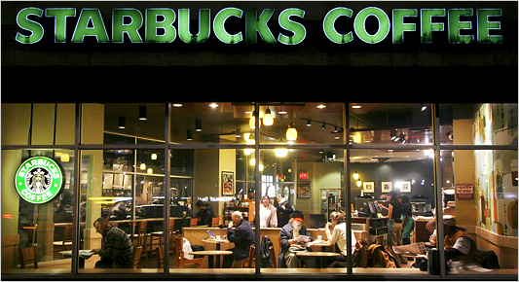
Questions?

